Slide 1
Stochastic Collapsed Variational Bayesian Inference for Latent Dirichlet Allocation
James Foulds¹, Levi Boyles¹, Christopher DuBois²
Padhraic Smyth¹, Max Welling³
¹ University of California Irvine, Computer Science
² University of California Irvine, Statistics
³ University of Amsterdam, Computer Science

Slide 2
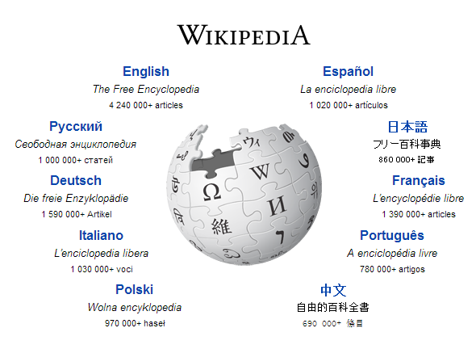
Let’s say we want to build an LDA topic model on Wikipedia

Slide 3
LDA on Wikipedia
10 mins
1 hour
6 hours
12 hours

Slide 4
LDA on Wikipedia
10 mins
1 hour
6 hours
12 hours

Slide 5
LDA on Wikipedia
1 full iteration = 3.5 days!
10 mins
1 hour
6 hours
12 hours

Slide 6
LDA on Wikipedia
Stochastic variational inference
Stochastic variational inference
10 mins
1 hour
6 hours
12 hours

Slide 7
LDA on Wikipedia
Stochastic collapsed variational inference
10 mins
1 hour
6 hours
12 hours

Slide 8
Available tools
 | VB | Collapsed Gibbs Sampling | Collapsed VB
Batch | Blei et al. (2003) | Griffiths and Steyvers (2004) | Teh et al. (2007), Asuncion et al. (2009)
Stochastic | Hoffman et al. (2010, 2013) | Mimno et al. (2012) (VB/Gibbs hybrid) | ???

Slide 9
Available tools
 | VB | Collapsed Gibbs Sampling | Collapsed VB
Batch | Blei et al. (2003) | Griffiths and Steyvers (2004) | Teh et al. (2007), Asuncion et al. (2009)
Stochastic | Hoffman et al. (2010, 2013) | Mimno et al. (2012) (VB/Gibbs hybrid) | ???

Slide 10
Outline
Stochastic optimization
Collapsed inference for LDA
New algorithm: SCVB0
Experimental results
Discussion

Slide 11
Stochastic Optimization for ML
Batch algorithms
While (not converged)
Process the entire dataset
Update parameters
Stochastic algorithms
While (not converged)
Process a subset of the dataset
Update parameters

Slide 12
Stochastic Optimization for ML
Batch algorithms
While (not converged)
Process the entire dataset
Update parameters
Stochastic algorithms
While (not converged)
Process a subset of the dataset
Update parameters

Slide 13
Stochastic Optimization for ML
Stochastic gradient descent
Estimate the gradient
Stochastic variational inference
(Hoffman et al. 2010, 2013)
Estimate the natural gradient of the variational parameters
Online EM (Cappe and Moulines, 2009)
Estimate E-step sufficient statistics

Slide 14
Collapsed Inference for LDA
Marginalize out the parameters, and perform inference on the latent variables only
Simpler, faster and fewer update equations
Better mixing for Gibbs sampling
Better variational bound for VB (Teh et al., 2007)

Slide 15
A Key Insight
VB Stochastic VB
Document parameters
Update after every document

Slide 16
A Key Insight
VB Stochastic VB
Document parameters
Collapsed VB Stochastic Collapsed VB
Word parameters
Update after every document
Update after every word?

Slide 17
Collapsed Inference for LDA
Collapsed Variational Bayes (Teh et al., 2007)
K-dimensional discrete variational distributions for each token
Mean field assumption

Slide 18
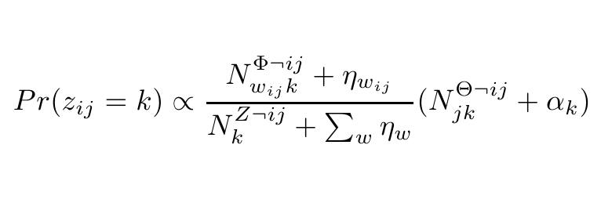
Collapsed Inference for LDA
Collapsed Gibbs sampler

Slide 19
Collapsed Inference for LDA
Collapsed Gibbs sampler
CVB0 (Asuncion et al., 2009)

Slide 20
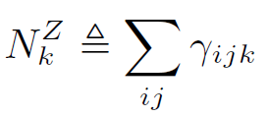
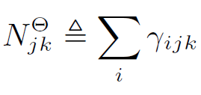
CVB0 Statistics
Simple sums over the variational parameters

Slide 21
Stochastic Optimization for ML
Stochastic gradient descent
Estimate the gradient
Stochastic variational inference
(Hoffman et al. 2010, 2013)
Estimate the natural gradient of the variational parameters
Online EM (Cappe and Moulines, 2009)
Estimate E-step sufficient statistics
Stochastic CVB0
Estimate the CVB0 statistics

Slide 22
Stochastic Optimization for ML
Stochastic gradient descent
Estimate the gradient
Stochastic variational inference
(Hoffman et al. 2010, 2013)
Estimate the natural gradient of the variational parameters
Online EM (Cappe and Moulines, 2009)
Estimate E-step sufficient statistics
Stochastic CVB0
Estimate the CVB0 statistics

Slide 23
Estimating CVB0 Statistics

Slide 24
Estimating CVB0 Statistics
Pick a random word i from a random document j

Slide 25
Estimating CVB0 Statistics
Pick a random word i from a random document j

Slide 26
Stochastic CVB0
In an online algorithm, we cannot store the variational parameters
But we can update them!

Slide 27
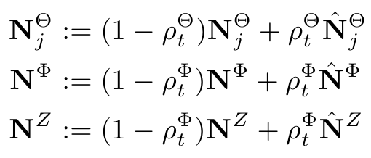
Stochastic CVB0
Keep an online average of the CVB0 statistics

Slide 28
Extra Refinements
Optional burn-in passes per document
Minibatches
Operating on sparse counts

Slide 29
Stochastic CVB0 Putting it all Together

Slide 30
Theory
Stochastic CVB0 is a Robbins Monro stochastic approximation algorithm for finding the fixed points of (a variant of) CVB0
Theorem: with an appropriate sequence of step sizes, Stochastic CVB0 converges to a stationary point of the MAP, with adjusted hyper-parameters

Slide 31
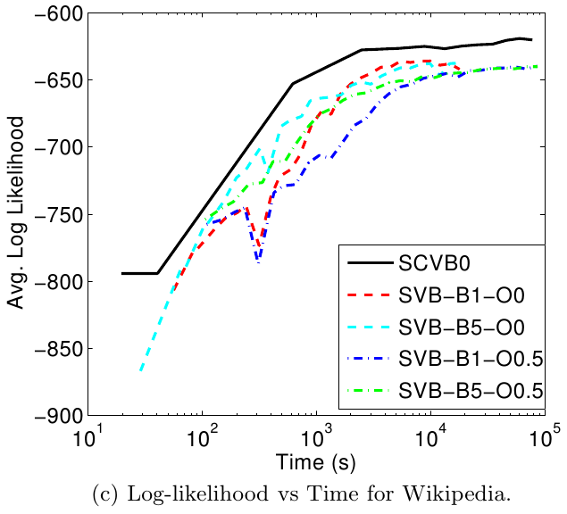
Experimental Results – Large Scale

Slide 32
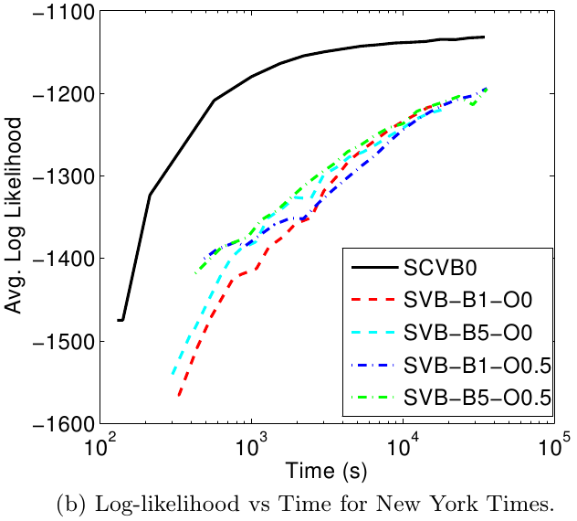
Experimental Results – Large Scale

Slide 33
Experimental Results – Small Scale
Real-time or near real-time results are important for EDA applications
Human participants shown the top ten words from each topic

Slide 34
Experimental Results – Small Scale
Mean number of errors
NIPS (5 Seconds)
New York Times (60 Seconds)
Standard deviations:
1.1
1.2
1.0
2.4

Slide 35
Discussion
We introduced stochastic CVB0 for LDA
Combines stochastic and collapsed inference approaches
Fast
Easy to implement
Accurate
Experimental results show SCVB0 is useful for both large-scale and small-scale analysis
Future work: Exploit sparsity, parallelization,
non-parametric extensions

Slide 36
Thanks!
Questions?

